Slide 1

Homework Assignment for Senior Marketing Analyst
Rafael Fagundes
Sep 2025

Slide 2

About me
Rafael Fagundes
Data & CRM Analyst with 10+ years experience turning data into growth
10+ years in data, CRM & marketing analytics
Experience at Dell, Nestlé, Samsung, HP in international & multicultural teams
Skilled in SQL, Python, BI tools (Power BI, Tableau, Looker)
Strong background in data-driven growth, campaign performance & funnel optimization
Excited to help Eduki optimize marketing performance and make smarter, data-driven decisions

Slide 3
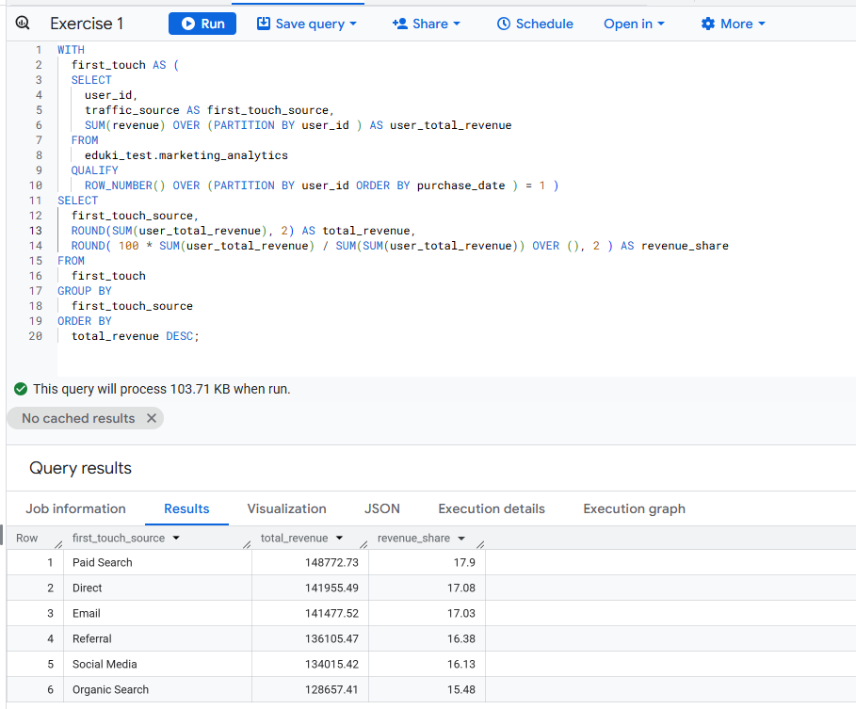
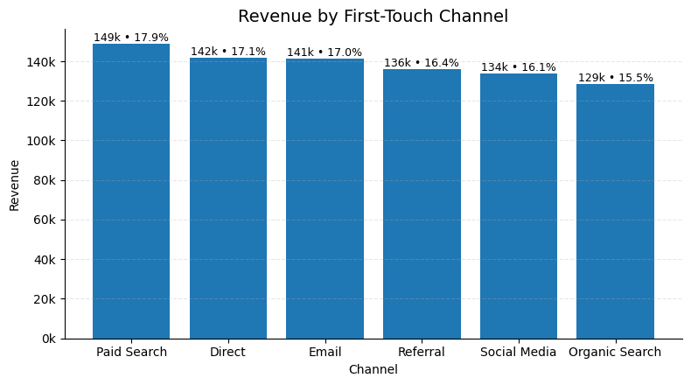
1) Revenue Contribution by First-Touch Channel
Q1: Calculate the revenue contribution of each traffic source, considering only first-touch attribution. Which traffic source has the highest impact on revenue?
Paid Search drives the highest revenue (17.9%), but Direct (17.1%) and Email (17.0%) are nearly as impactful. This shows multiple channels contribute strongly at the start of the funnel.

Slide 4
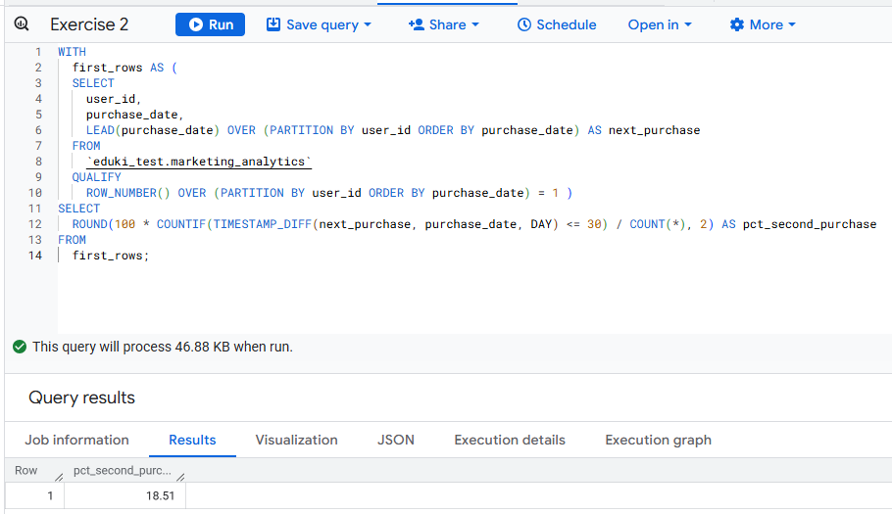
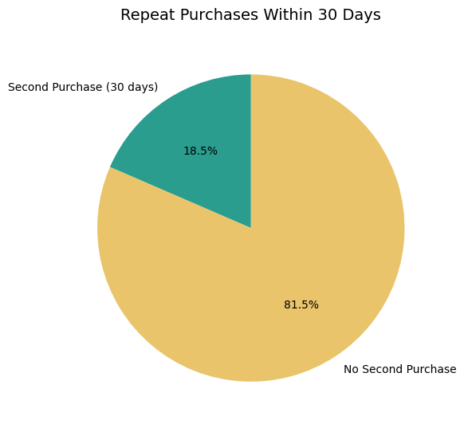
2) Repeat Purchases Within 30 Days
Q2: Identify customers who made a second purchase within 30 days after their first purchase. What percentage of total customers do they represent?
18.5% of customers made a second purchase within 30 days of their first order. This shows that nearly 1 in 5 customers return quickly, highlighting an opportunity to focus on early retention campaigns (e.g., post-purchase email flows, cross-sell offers).

Slide 5
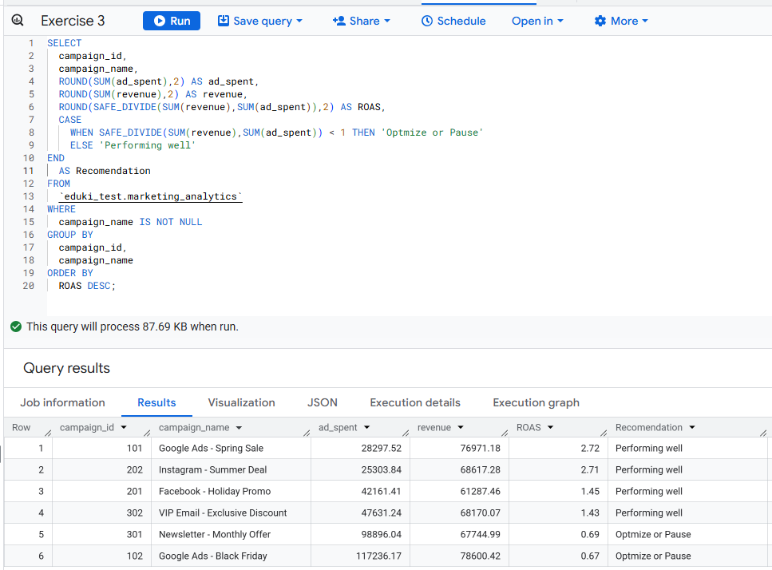
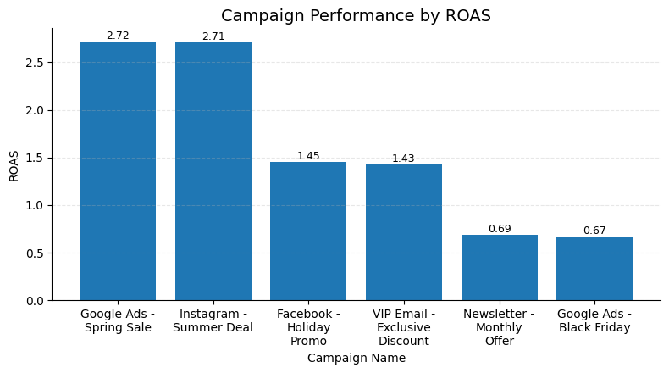
3) Campaign Performance by ROAS
Q3: Compute the ROAS (Return on Advertising Spend) for each campaign. Which campaigns are below the break-even point and should be optimized or paused?
Two campaigns, Newsletter (ROAS 0.69) and Google Ads Black Friday (ROAS 0.67), are below break-even and should be optimized or paused. Other campaigns, such as Spring Sale (ROAS 2.72) and Instagram Summer Deal (ROAS 2.71), are performing strongly and should continue to receive investment.

